Slide 1
MIS 321
XUnit

Slide 2
Create A Program To Test
Create a console app
Create a Utility class
Create an Add method that accepts two int and returns the sum
Create a Subtract method that accepts two ints and returns the difference
Create an IsOdd method that accepts an int and returns a bool of true if the number is odd and false if it is even

Slide 3
Install Packages
Microsoft.NET.Test.Sdk
xunit
xunit.runner.visualstudio

Slide 4
Multiple Entry Points
If you tried to run your app or build your app at this point it would fail.
You now have two entry points into your app. Main and the test harness you just created.
To correct, in your csproj file, below the TargetFramework line add the following:
<GenerateProgramFile>false</GenerateProgramFile>

Slide 5
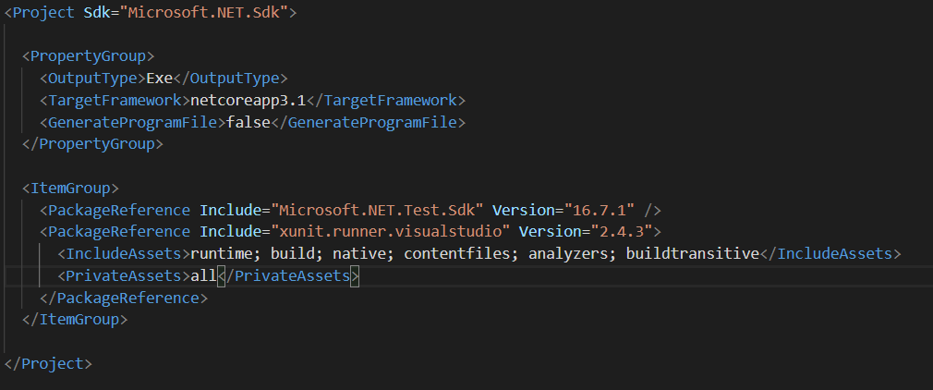
Multiple Entry Points – Example csproj File

Slide 6
Add A Test Class
Create a tests folder
Create new class in the tests folder. Name the class Test_Utility
Add using Xunit; statement

Slide 7
The AAA Pattern
Before we write our first test, let’s understand the typical pattern for writing test methods
Arrange – Initialize objects and set data values that will be passed to the method being tested
Act – Invoke the method being tested
Assert – Verify the method being tested provided expected results

Slide 8
Write First Test
Create a method called Test_Add
Add the [Fact] attribute before the method header
Arrange
Instantiate a Utility object
Set int variable called expected = 4
Act
Set int variable called actual to myObject.Add(3,1);
Assert
Call the Assert method and determine if the actual amount equals the expected amount. i.e.
Assert.Equal(expected, actual);

Slide 9
Fact Vs Theory
xUnit supports 2 types of unit tests: facts and theories.
Facts are used to test invariant conditions
Theories are tests that are true for a particular set of data passed as argument to the method
Typically use the [Fact] attribute to write unit tests that have no method arguments

Slide 10
Create Theory Test
Create a method called TestIsOdd
Pass in an int to the method
Instantiate a utility object
Call Assert.True(myObject.IsOdd(myInt));
Add the [Theory] attribute before the method
Add Several test cases for the method:
[InlineData(3)]
[InlineData(9)]
[InlineData(12)]

